Slide 1

RUSSIAN - ARMENIAN UNIVERSITY
Institute of Mathematics and Computer Science
Content Parser
PROJECT ADVISOR: ADAM MATHIAS BITTLINGMAYER
AUTHOR : SARGIS ABRAHMAYAN

Slide 2
Agenda
Introduction
Data collection
Data labeling
Model Construction
Results

Slide 3
Introduction
ContentParser is learning approach for parsing HTML content
Autonomous product which collects and parses data in the whole web
Model which learns the pages content using the data
Predicts the content of given HTML page

Slide 4

Visual Introduction
Here is what we have !

Slide 5
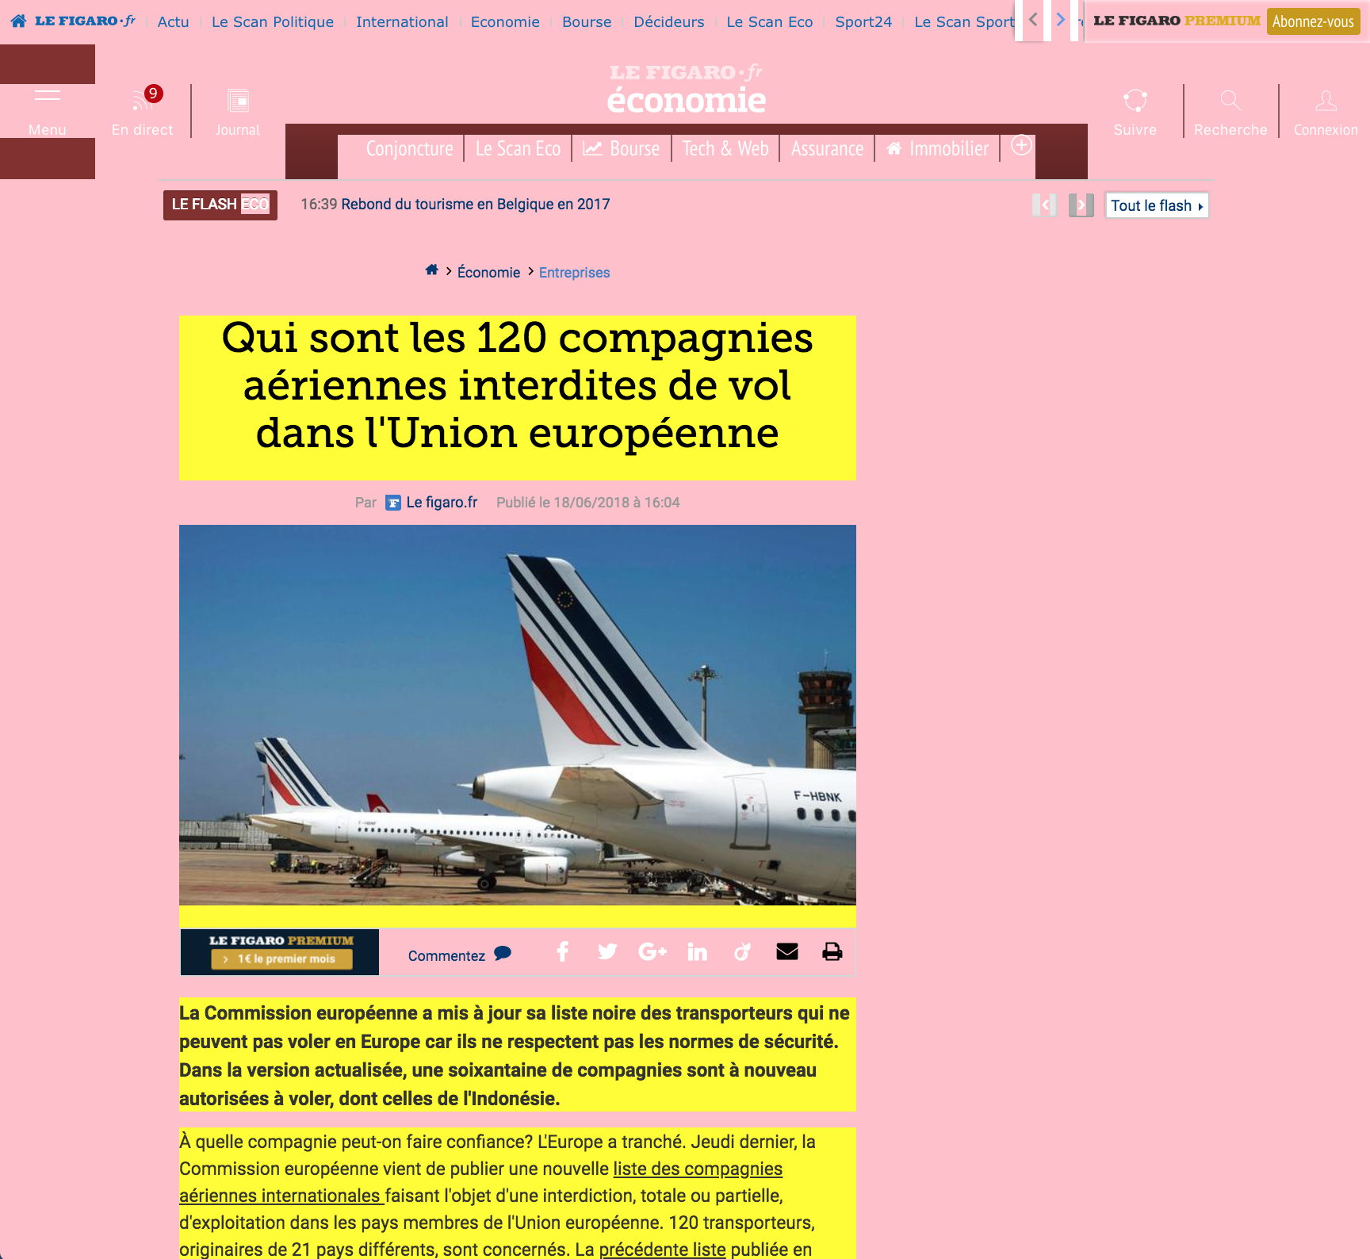
Visual Introduction
What we need !

Slide 6
Building Dataset
HTMLParser: Collection of URLs
Initial flow of the data collection
Collects “all” pages from web
HTMLParser Python based programm
URL Categorization
Labeling Data
Labeling on “Firefox”
Labeling on “Chrome”
Notes:
I will present you each part of the programm with its technical part, to not be bored

Slide 7


HTMLParser: URL Collection
HTMLParser autonomous python application which will collect whole web without human engagement
This program needs only 1 web page to start the work
URL 1
URL 2
URL n
URL 0
(URL,HTML)
HTMLParser
Notes:
Multithread

Slide 8
HTMLParser:URL Collection Implementation
def parse_pages(raw_urls, parsed_urls):
current_url = raw_urls.pop(0)
print("URL processing - ", current_url)
if is_url_processed(current_url, parsed_urls):
return
encoded_url = encode_url(current_url)
url_content_path = os.path.join(CONTENT_FOLDER, encoded_url)
url_html_path = os.path.join(HTML_FOLDER, encoded_url)
parser = parse_page(current_url)
if parser is None:
return
if not os.path.exists(url_content_path) :
try :
with open(url_content_path, "w+") as current_file:
current_file.write(parser.get_data())
with open(url_html_path, "w+") as current_file:
current_file.write(parser.get_html())
except Exception as e:
print("Error:", e)
nested_urls = parser.get_nested_urls()
parser.close()
parsed_urls.append(current_url)
for nested_url in nested_urls:
if nested_url not in parsed_urls :
raw_urls.append(nested_url)
print("URL processed - ", current_url)
URL 1
URL 2
URL n
URL 0
(URL,HTML)
HTMLParser
Notes:
Multithread

Slide 9
URL Categorization
Final stage of the collection
Categorizes the collected urls by domain
Notes:
Multithread

Slide 10
HTMLLabler
Node JS project to read the text
Read the page for each URL
Apply the plugins for each line
Labeling on “Firefox”
Labeling on “Chrome”
Notes:
Multithread

Slide 11
HTMLLabler: Plugins
Each plugins is a rule based
Extracts page using tags
Notes:
Multithread

Slide 12
HTMLLabler: Implementation
console.log('Labelling text');
const readableLines = _.readable.text.split('\n');
for (let line of _.original.text.split('\n')) {
var label;
if (readableLines.includes(line)) {
label = '__label__keep';
} else {
label = '__label__delete';
}
datastream.write(label + " " + line +"\n"); }
We keep the line only if both plugins agreed to keep
Notes:
Multithread

Slide 13
Train Model
Train a classification model
Word representation learning
Training word vectors - Word2Vec
Text classification
Notes:
Here id two key things we do

Slide 14
Word Representation Learning
Word embedding is one of the most popular representation of document vocabulary. It is capable of capturing context of a word in a document, semantic and syntactic similarity, relation with other words
Word2Vec model used as a
Notes:
Here id two key things we do

Slide 15
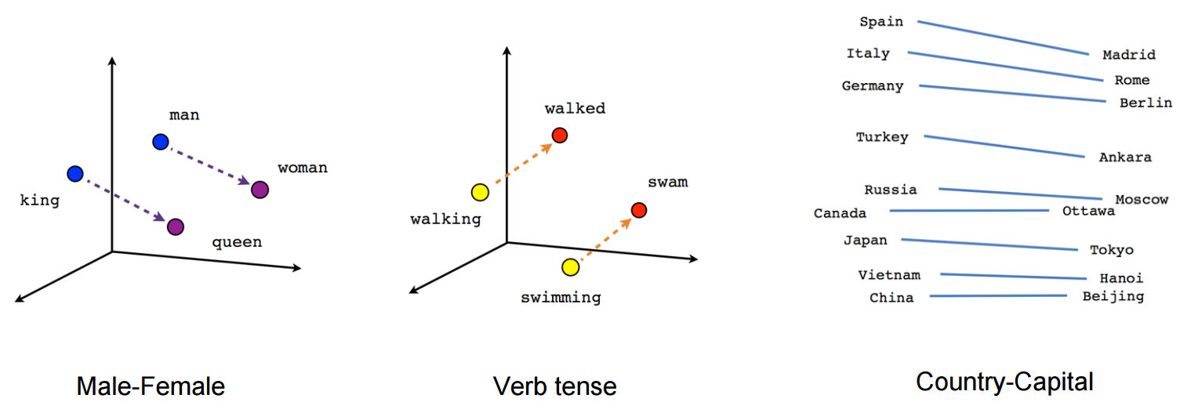
Word Embedding
Word embedding is one of the most popular representation of document vocabulary. It is capable of capturing context of a word in a document, semantic and syntactic similarity, relation with other words
Word2Vec model is used to produce word embedding
Notes:
Here id two key things we do

Slide 16
Out-of-vocabulary words - OOV
Given an OOV word and the sentence it is in, language modelling is used to sequence words in the sentence and predict the meaning of the word by comparison with similar sentences
Notes:
“Word2vec takes as its input a large corpus of text and produces a vector space, typically of several hundred dimensions, with each unique word in the corpus being assigned a corresponding vector in the space.

Slide 17
Train Classification Model
We run fastText supervised to train a simple classification model to predict the label for each section, which can be applied to keep or delete it.
fasttext supervised -minn 1 -maxn 3 ...
Notes:
“Word2vec takes as its input a large corpus of text and produces a vector space, typically of several hundred dimensions, with each unique word in the corpus being assigned a corresponding vector in the space.

Slide 18
Results
We ran fastText with the following parameters:
fasttext supervised -minn 1 -maxn 3 …
Number of examples: 1078868
Trained on 18.5M lines (~30K web pages)
Tested on 1M lines
Accuracy 94.1%
Notes:
“Word2vec takes as its input a large corpus of text and produces a vector space, typically of several hundred dimensions, with each unique word in the corpus being assigned a corresponding vector in the space.

Slide 19
Future Work
Runner module to run fasttext and return the content
Upload trained mode
Notes:
“Word2vec takes as its input a large corpus of text and produces a vector space, typically of several hundred dimensions, with each unique word in the corpus being assigned a corresponding vector in the space.

Slide 20
Check ContentParser Result
Compare the result with existing rules based browsers plugins
Compare the result with the data collected by human

Slide 21
New Directions to explore
Parsing news
Finance Market trend prediction by classifying the news.
Assistant product integration
can be integrated in existing smart assistent products such as Cortana, Google Assistant

Slide 22
Links
Github
ContentParser - https://github.com/sargisabrahamyan/contentparser
Fasttext - https://fasttext.cc/docs/en/support.html
Word Embedding - https://towardsdatascience.com/word-embedding-with-word2vec-and-fasttext-a209c1d3e12c

Slide 23
Thank you

